Slide 1
Azure Functions Deep Dive
Colby Tresness
Program Manager – Azure Functions
@ColbyTresness
Eduardo Laureano
Principal PM Manager – Azure Functions
@eduardolaureano

Slide 2
Agenda
Serverless Basics & Intro to Functions
Functions Architecture
Limitations, issues, best practices
Durable Functions Deep Dive
Roadmap
Customer Usage
Useful Resources
Final Thoughts

Slide 3
Build apps faster with PaaS and Serverless
Serverless
Value to business
Innovation
PaaS
Efficiency
IaaS
Time
Notes:
In today’s cloud enabled world, businesses are solving for maximum efficiency and faster time to market, while reducing IT spend.
Over the years we have seen businesses evolve from spinning VMs to leveraging the benefits of PaaS cloud such as managed infrastructure, scalability, high availability and cost.
Today, more businesses are trying to solve for what is core to their business focus – delivering services faster to their customers, while reducing IT spend significantly. The answer comes in the form of Serverless application platform.
In industry terms, when you hear someone say “Serverless” more often than not they are talking about Serveless Compute services which form the glue that enable developers to build their apps faster leveraging a variety of other PaaS services.
Serverless lets businesses maximize their benefits of the PaaS cloud by offering a fully managed infrastructure, with no servers to manage, provision and patch; hence reducing management overhead significantly. The event triggered programming model, allows for continuous auto-scaling and micro billing capabilities. Event-triggered compute and event-triggered scaling allows businesses to pay only for the compute power that was used, depending on the size of the workload.

Slide 4





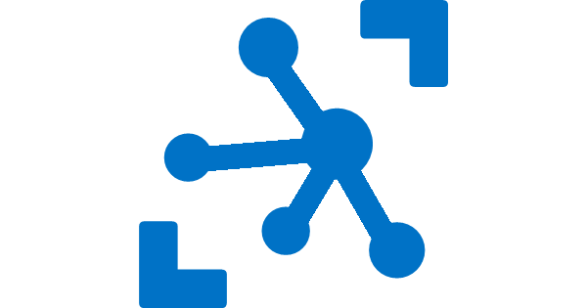


Serverless application platform components
Development
Platform
IDE support
Event Grid
Logic Apps
Functions
Manage all events that can trigger code or logic
Design workflows and orchestrate processes
Execute your code based on events you specify
Integrated DevOps
Local Development
Monitoring
Database
Storage
Security
IoT
Analytics
Intelligence
Visual Debug History
Notes:
So we have a platform now. But how about the process of building these applications? How does the developer experience look like?
Where does Functions fit?

Slide 5






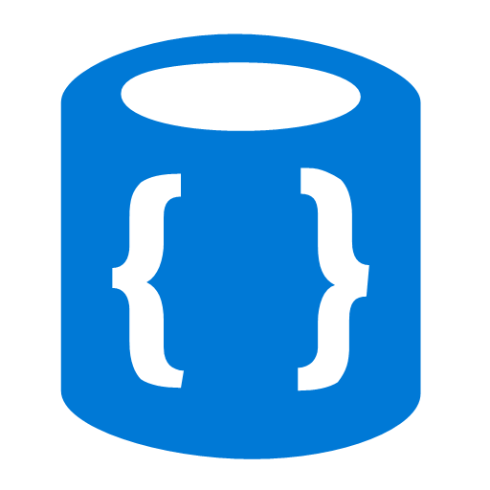


Azure Functions
Events
Code
Outputs
React to timers, HTTP, or events from your favorite Azure services, with more on the way
Author functions in C#, F#, Node.JS, Java, and more
Send results to an ever-growing collection of services
Notes:
Basic concept of functions – event-driven serverless code in whatever language you like.

Slide 6
Language Support
Languages | Status | Notes
C# | GA | C# Script and Class Libraries
JavaScript | GA | Node, 6.5.0 and 8.4.0
F# | GA | F# Script and Class Libraries
Java | Preview | Maven, Jenkins, Eclipse, VS Code Supported
Additional Experimental Languages: Python, Bash, Powershell, Batch, PHP, TypeScript
Notes:
Per previous slide, you can write Functions in many languages, with more on the way!
All experimental means is that its meant for POCs rather than production workloads in its current state.

Slide 7
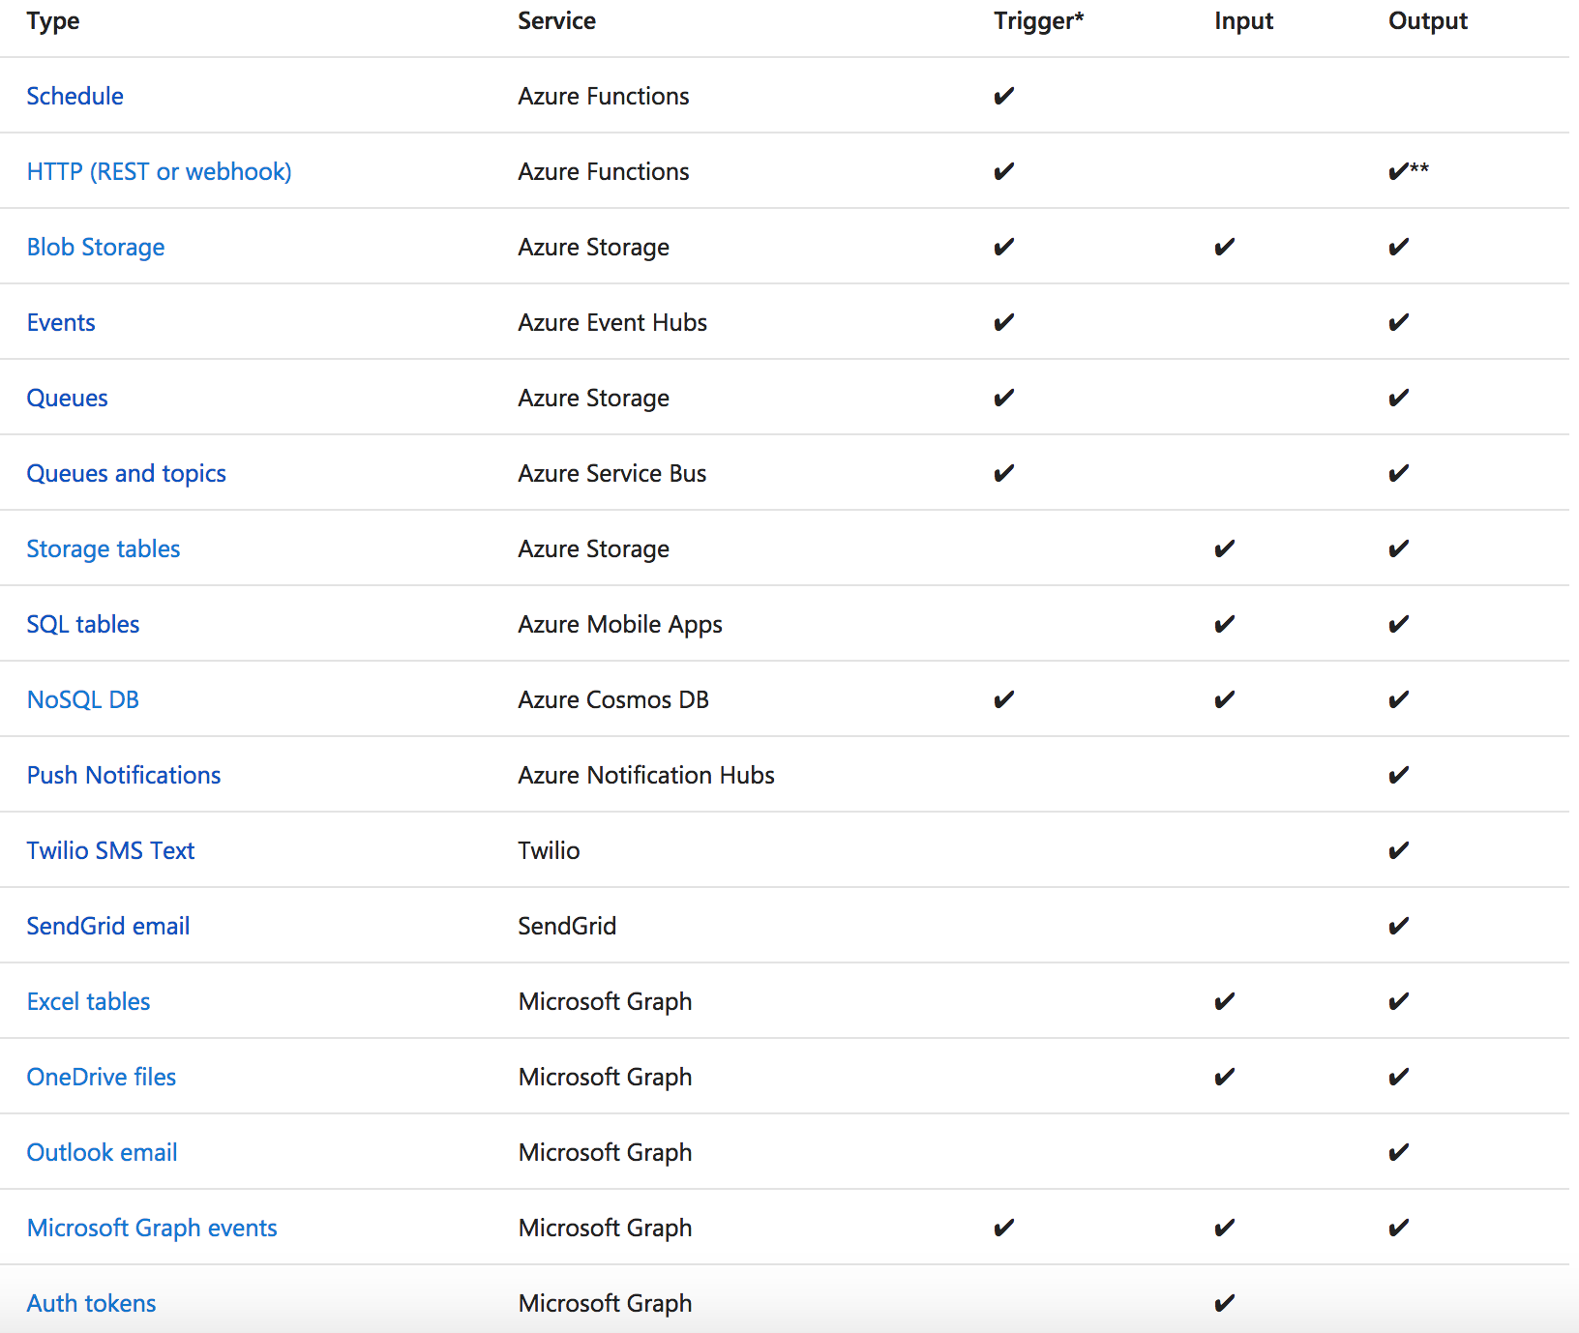
Functions triggers and bindings
Notes:
As I mentioned earlier, triggers and bindings are the things that facilitate easy communication with other services. This chart shows us the triggers and bindings currently supported. As we can see, there are a number of Azure services supported here…. for Storage, Database, Messaging, Notifications and so on. In addition to those, Functions also support generic Http triggers, which means you can easily write a piece of code that can be used to respond to REST requests or requests from any service that supports webhooks. This also provides a really fast and easy mechanism for building extensions to SaaS applications. We are fully committed to making this list grow and making more check-marks appear in that table.

Slide 8
Development tools
Monitoring: App Insights
Local debugging: VS, VS Code
Run locally: X-Plat CLI
Publish: VSTS, Maven
CD: GitHub, BitBucket, Jenkins…
Inner loop
Outer loop
Notes:
Inner loop: a developers life day to day, writing and debugging code
Outer loop: a developers life week to week, pushing code and monitoring their service
We fulfill developer needs for both scenarios.

Slide 9
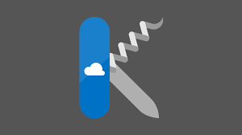
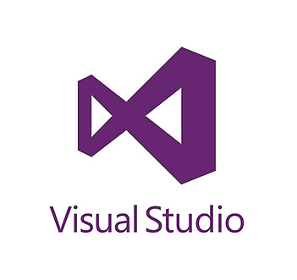
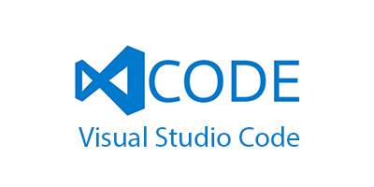

Azure Functions Tooling Options
Portal (with Kudu)
Visual Studio
VS Code
CLI

Slide 10



Ways to Run Functions
Consumption
Serverless
App Service Plan
Free, Basic, Standard, Premium
App Service Environment
Network Isolation
Azure Stack
On Premises
Azure Functions Runtime (preview)
Functions on your Server
Azure IoT Edge (preview)
On Devices
Pay only for what you use! Metering is per execution and per GB Second.
All the advantages of Functions with the SLA and ‘always on’ features of an App Service Plan.
Your own dedicated cloud environment with network isolation for apps, higher scale, and the ability to connect securely to local vNets.
Leverage cloud innovations in on-premises infrastructure. Azure Stack brings the power of Azure to your own data centers.
Run on IoT Devices by deploying custom modules.
Run your Azure Functions on your local server (without the rest of Azure)

Slide 11
Monitoring
Monitor
What is my app doing?
Alert
Is my app unhealthy?
Diagnose
Why is it unhealthy?
Learn
What was my app doing?
Notes:
“Why is monitoring important”

Slide 12
Demo
Monitoring a Rapidly Scaling Function

Slide 13
Runtimes and Languages – V1 Runtime (GA)
Host runs .NET Framework 4.6.1
C#/F# Functions run in same host process (.NET Framework 4.6.1)
Node.js also runs in same host process (using Edge – LOCKED at Node 6.5.0)
A few other “experimental” languages that also run in process. Not a scalable model.

Slide 14
Runtimes and Languages – V2 Runtime (Preview)
Host runs .NET Core 2.0
C#/F# Functions run in same host process (.NET Core 2.0)
New extensibility model for languages where “language workers” run out-of-process.
Node.js – defaults to 8.4.0 but now can opt in to newer versions
Java
Python (early in progress)
Other languages in discussion / investigation
New extensibility model for bindings
Lighter core runtime
Version control
Today requires you manually “func extensions install” to use bindings / triggers

Slide 15
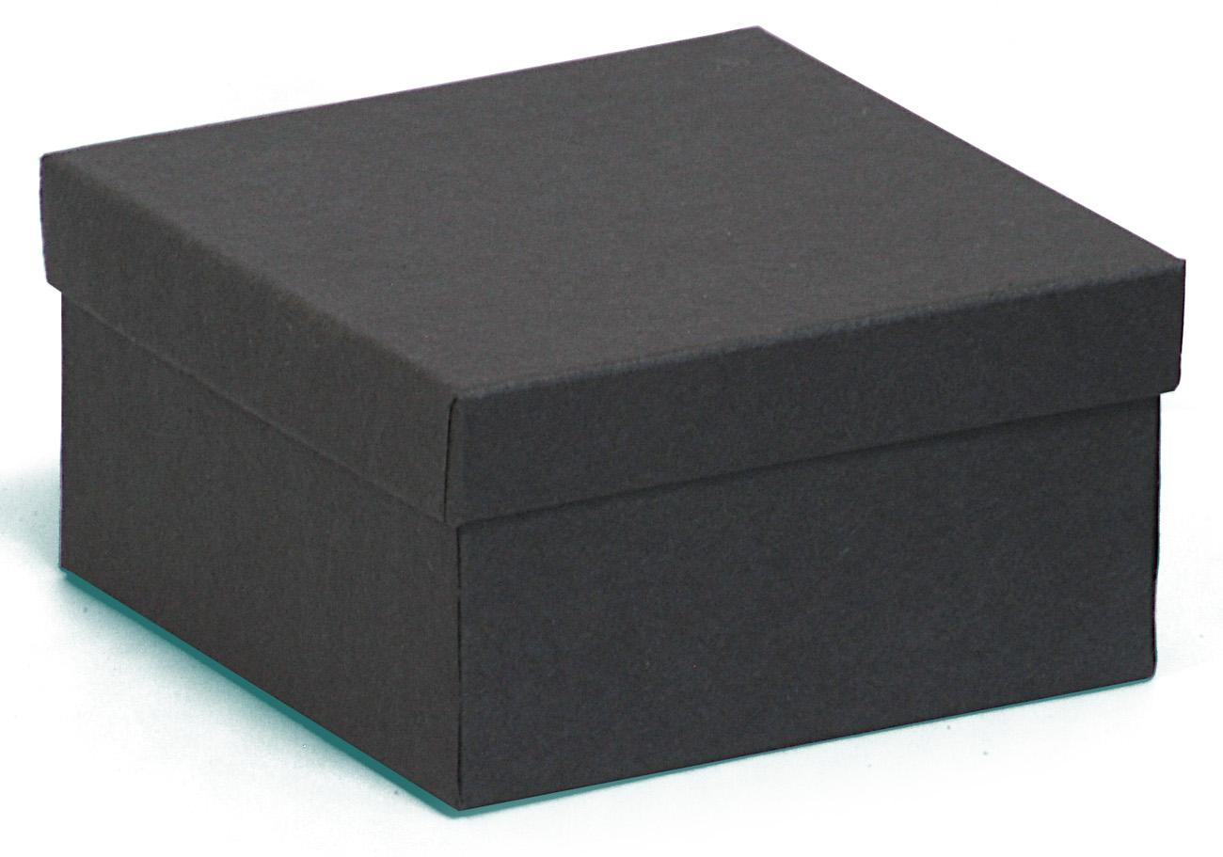
Azure Functions “Behind the scenes”
HTTP Request
HTTP Response

Slide 16
Functions “Behind the scenes”
App Services Infrastructure
Functions Instance
Azure Functions Runtime
HTTP Request
Azure Functions (App Services) HTTP Front-end
Functions Instance
HTTP Response
Azure Functions Runtime
Scale Controller
Functions Instance
Azure Functions Runtime

Slide 17
Scalability Considerations
The “Scale Controller” determines how many instances are actively doing work
For Event Hub, Queue, Service Bus the scale controller can assess message backlog length and burndown rate to scale
For HTTP functions today looks at request queue for each instance
The “host.json” config file allows you to set instance limits for concurrency at an instance level
Other knobs are to turn of file-system logging, and not include a dashboard storage account
Process items in a batch-per-execution for high scale scenarios (e.g. Event Hub)

Slide 18
Cold Start
The time it takes to ready an instance when no instance yet exists
Varies greatly on a number of factors like language and # of files
Today for C# in v1 is generally around 3-4 seconds today, 1-2 seconds in on-deck release
Few angles of attack
Pre-warmed “workers”
Zipped artifacts without extract (Zip Deploy)
Keep alive (keep warm longer)
Users can help mitigate by:
Using Zip Deploy if possible (paired with something like funcpack for Node)
Use C# Class Libraries over .csx for large functions
If push comes to shove, a “pinger” can keep warm

Slide 19
Best Practices
Use App Insights EVERYTIME
Do as little work synchronously as possible
Trigger in batches
Don’t forget to catch exceptions
Global static variables for things like HttpClient or “cached” values
Don’t forget about the host.json file
VSTS Release Management pipeline for DevOps
Can also do GitHub / Source Control deploy for “simple” CI/CD

Slide 20
Durable Functions

Slide 21
Durable Functions
Azure Functions extension
Enables long-running, stateful serverless operations
Write complex function orchestrations in a single C# function
Manages state, checkpoints and restarts
Built on the open-source Durable Task Framework
Notes:
Durable Functions is an Azure Functions extension that enables long-running, stateful serverless operations. With Durable Functions, you can coordinate complex functions workflows in a single C# function.

Slide 22
Key Concepts
Activity function
Orchestrator function
Bindings
Event sourcing

Slide 23
Activity Function
public static string SayHello(string name)
{
return $"Hello {name}!";
}
Notes:
Activity Functions are functions as you’re used to them. There are no restrictions on what they can do (apart from those on all functions.) In a Durable Function orchestration, the bulk of the work takes place here.

Slide 24
Orchestrator Function
// calls functions in sequence
public static async Task<List<string>> Run(DurableOrchestrationContext context)
{
var outputs = new List<string>();
outputs.Add(await context.CallActivityAsync<string>("SayHello", “Seattle"));
outputs.Add(await context.CallActivityAsync<string>("SayHello", “Amsterdam"));
// returns ["Hello Seattle!", "Hello Amsterdam!"]
return outputs;
}
Notes:
Orchestrator Functions are special to the Durable Functions extension. An orchestration function coordinates the calling of one or more activity functions. It’s where you define your workflow.
An orchestrator function can call other functions synchronously or asynchronously. Whenever an await instruction is encountered, the orchestrator function will automatically checkpoint its progress. This way, if the process or VM your function is running on recycles or reboots, local state isn’t lost.
The example onscreen is simple for the sake of space, but as we’ll see in later examples, orchestrator functions can define complex workflows including:
Flow control and branching logic
Infinite loops
Error handling

Slide 25
Event Sourcing
Local state as append-only execution history of actions
Orchestrator function schedules async work, shuts down
Orchestrator restarts and rebuilds its local state
Improved performance and scalability
Eventual consistency
Full audit trails and history
Notes:
Orchestrator functions maintain their state using a cloud design pattern called Event Sourcing. Instead of storing a single state, they store an execution history, or an append-only record of actions taken by the orchestration.
Orchestrator functions add to the execution history when they encounter an await statement, schedule the requested async work, and shut down. (Meaning that while you get billed for the execution time of the scheduled work, you don’t get billed for the orchestrator function waiting for the work to complete.) Once there’s more work to do, the orchestrator function wakes up and rebuilds its local state from its execution history.
This pattern has a lot of advantages, including improved performance and scalability, eventual consistency for transactional data, and full audit trails and history.

Slide 26
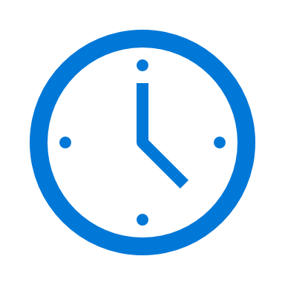

var outputs = new List<string>();
outputs.Add(await context.CallActivityAsync<string>("SayHello", “Amsterdam"));
return outputs;
Orchestrator Function
Orchestrator Function
Activity Function
Orchestrator Started
Activity Function
Execution Started
Task Scheduled, SayHello, “Amsterdam”
Orchestrator Completed
[“Hello Amsterdam!”]
“Hello Amsterdam!”
“Hello Amsterdam!”
Task Completed, “Hello Amsterdam!”
?
Orchestrator Started
Execution Completed, ["Hello Amsterdam!"]
Orchestrator Completed
Execution History
Notes:
Grasping how orchestrators use execution history to replay and rebuild their local state is key to understanding how Durable Functions works, so let’s walk through the execution of a simple orchestrator function.
The light blue box at the top of the slide is the orchestrator’s code.
“SayHello” our activity function, which returns “Hello” and whatever input you give it.
Our execution history is currently empty. As we start to record events, they’ll show up here. (Indicate area.)
1. A request is made to the orchestrator function.
2. The orchestrator starts and begins executing until it’s asked to await some async work. In this case, we want to call an activity function.
3. The orchestrator checks the execution history for a record of the activity function.
4. There’s no record of the activity function being called or completed, so the orchestrator schedules that work.
5. While the orchestrator waits on work to complete, it shuts down.
5. The scheduled activity function runs.
6. A record of this is added to the execution history. In this case we produced output, so that’s stored.
7. Now the orchestrator has more work to do. It restarts and executes its code **from the beginning** to build up its local state.
8. As before, the orchestrator executes until it reaches an await.
9. The orchestrator checks the execution history. This time there’s a record of the async work being done.
10. The activity function’s stored output is passed back to the orchestrator. In this case, the value is added to a list of strings.
11. The orchestrator continues executing. In a more complex orchestrator with multiple await calls, the checkpoint, schedule and replay steps would repeat for each one. This orchestrator runs to completion and returns its output.
12. And we’re done!
- How does the framework know to wake up

Slide 27

Pattern #1: Function Chaining
F1
F2
F3
F4
// calls functions in sequence
public static async Task<object> Run(DurableOrchestrationContext ctx)
{
try
{
var x = await ctx.CallFunctionAsync("F1");
var y = await ctx.CallFunctionAsync("F2", x);
var z = await ctx.CallFunctionAsync("F3", y);
return await ctx.CallFunctionAsync("F4", z);
}
catch (Exception)
{
// global error handling/compensation goes here
}
}
Notes:
With the basics down, I’m going to cover some patterns that are easy to implement in Durable Functions.
The first is Function Chaining, where the output of one function becomes input for the next. It’s possible to do this with regular Functions alone – you could, for example, store a function’s output in a queue to be picked up by the next function in the sequence. However:
Queues create additional overhead.
There’s no visualization showing the relationship between the functions. (You could maintain a separate document, but that’s more maintenance overhead.)
Additional complexity arises when you consider error handling.
Durable Functions orchestrators are capable of the error-handling structures you’re used to like try-catch blocks and self-document the relationship between activity functions. Here’s what the one for this scenario would look like – note that since the activity functions’ return values are stored as local state, they’re maintained for you as part of the execution history.

Slide 28
Pattern #2: Fan-Out/Fan-In
F1
F3
F2
Notes:
Fan-out/fan-in involves execution multiple functions in parallel and waiting for them all to finish. Some aggregation work might be done on the results.
The fan-out part can be done with regular functions by sending multiple messages to a queue, but fan-in is significantly harder; you would need to keep track of when those queue-triggered functions finish and their outputs. The problems of visualization, overhead and error-handling are also still with us.

Slide 29
public static async Task Run(DurableOrchestrationContext ctx)
{
var parallelTasks = new List<Task<int>>();
// get a list of N work items to process in parallel
object[] workBatch = await ctx.CallActivityAsync<object[]>("F1");
for (int i = 0; i < workBatch.Length; i++)
{
Task<int> task = ctx.CallActivityAsync<int>("F2", workBatch[i]);
parallelTasks.Add(task);
}
await Task.WhenAll(parallelTasks);
// aggregate all N outputs and send result to F3
int sum = parallelTasks.Sum(t => t.Result);
await ctx.CallActivityAsync("F3", sum);
}
Notes:
As before, a Durable Functions orchestrator spells out the relationship between functions, handles storing state, and facilitates error-handling. Fan-in is handled by the highlighted line of code using the familiar WhenAll method of the .NET’s Task library.

Slide 30
Demo
Fan Out/Fan In

Slide 31
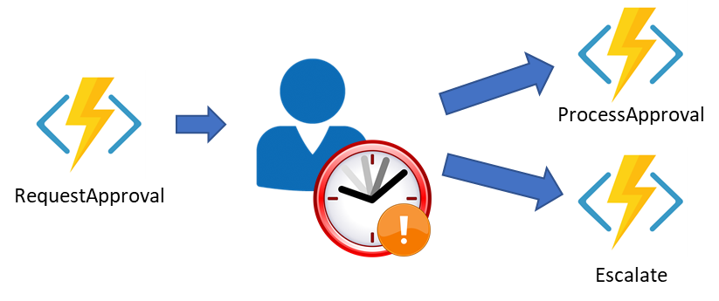
Pattern #3: Human Interaction w/Timeout
Notes:
Some workflows require a human interaction step which needs to account for a response that is delayed or never comes. For example, an approval process for an expense report might require an approval from a manager – but if the manager doesn’t respond within 72 hours, you want to escalate the approval request.
In this case, you have two competing events – the approval request notification and the timeout – that need to be coordinated. Depending on which event is received first, different actions need to be taken. There’s currently no way in regular functions to manage this sort of pattern, but it becomes simple with Durable Functions.

Slide 32
public static async Task Run(DurableOrchestrationContext ctx)
{
await ctx.CallActivityAsync<object[]>("RequestApproval");
using (var timeoutCts = new CancellationTokenSource())
{
DateTime dueTime = ctx.CurrentUtcDateTime.AddHours(72);
Task durableTimeout = ctx.CreateTimer(dueTime, 0, cts.Token);
Task<bool> approvalEvent = ctx.WaitForExternalEvent<bool>("ApprovalEvent");
if (approvalEvent == await Task.WhenAny(approvalEvent, durableTimeout))
{
timeoutCts.Cancel();
await ctx.CallActivityAsync("HandleApproval", approvalEvent.Result);
}
else
{
await ctx.CallActivityAsync("Escalate");
}
}
}
Notes:
The DurableOrchestrationContext object provides methods to create timers which can be used to re-activate the orchestrator function at a specified time. In the example above, we take the current time at which the orchestrator first runs and add 72 hours to it. Then, using Task.WhenAny, we wait on an external approval event or the timeout, and take action based on which event completed first.

Slide 33
Language Support
C# is the only officially supported language at this time.
JavaScript support is in-progress.
Notes:
Durable Functions is currently only officially supported in C#, and we’re actively working on adding support for other languages. First up is Node.JS, and if you’re interested, you can see how this is going on GitHub, because..

Slide 34
Important details/limitations
Orchestrator code replayed on every rehydration to restore local state
Functions calls aren’t replayed – the outputs are remembered.
Orchestrator code must be deterministic
Don’t write logic which depends on random numbers, DateTime.Now, etc.
Never do I/O directly in the orchestrator function
Don’t write infinite loops
Use the built in workarounds for #1-3

Slide 35
Roadmap And Customer Success

Slide 36


Serverless growth
Frameworks
.NET, Node,
Python, PHP
Triggers
Native, 1st party, 3rd party, custom
Connectivity
Bindings + Connectors
Tooling
VS, VS Code, CLI, MacOS / Linux

Slide 37
Functions Roadmap
Shipped in H1
Support for .NET core
App Insights integration
Java on Functions (Preview)
VS Code tooling
Functions Proxies GA
Functions on Linux (preview)
VS support for Functions v2
Planned in H2
Scalability improvements
Enhanced monitoring
Python support (preview)
Cold start improvements
Functions Portal on Mooncake and Fairfax
Proxies support on v2
Dynamic Functions on Linux (preview)
Durable Functions GA

Slide 38
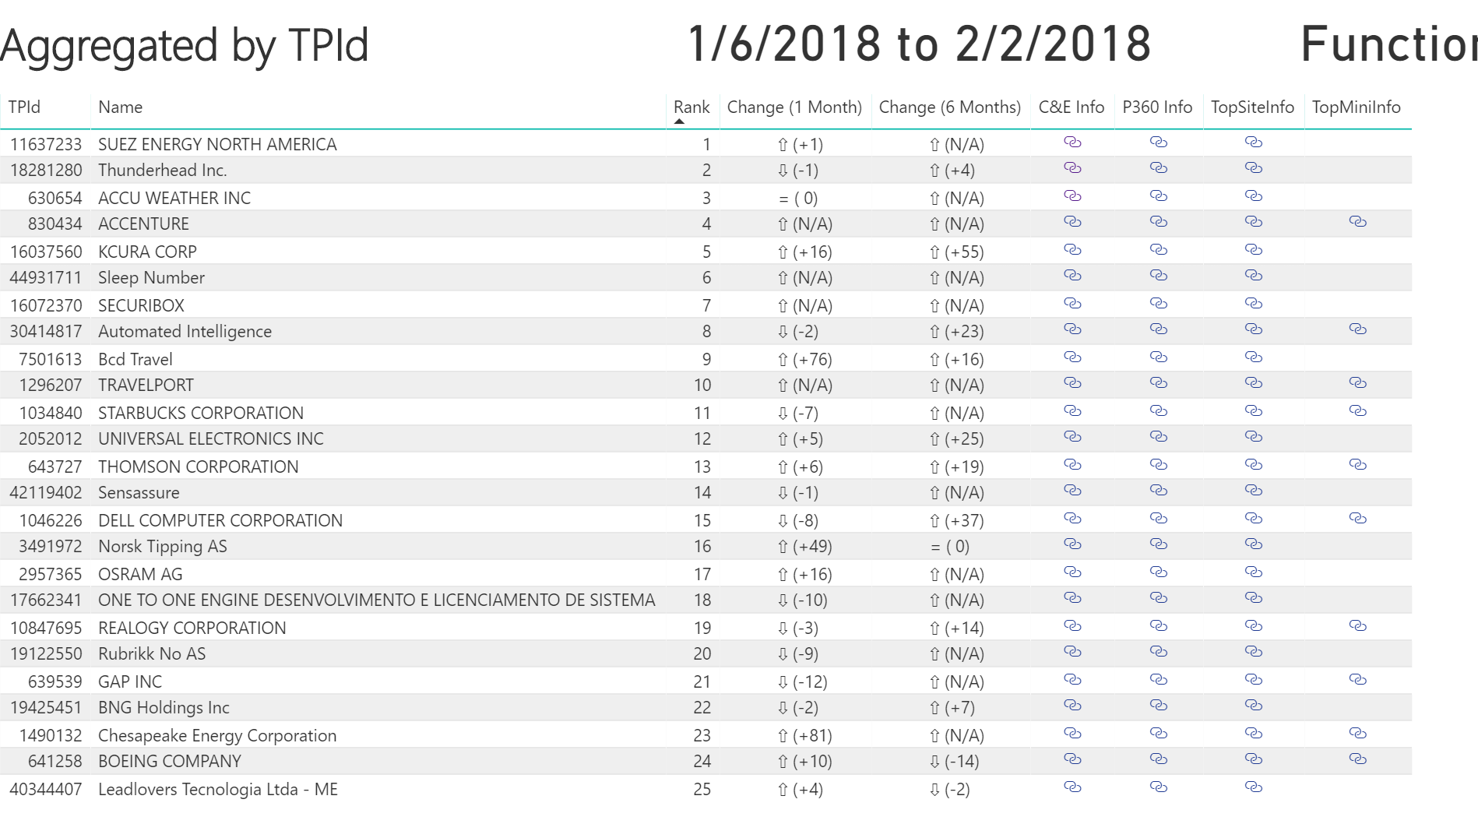
Top Customers List

Slide 39
Customer Reference Architectures
Example Business Use Cases for Functions
Reference Architectures

Slide 40
Tools to Learn More
Serverless Workshop
Another Serverless Workshop
Hands On Lab

Slide 41
Azure Functions is an Open Source project
https://github.com/Azure/Azure-Functions
Azure Functions Host - the Azure Functions runtime
Azure WebJobs SDK - the "core" of the Azure Functions runtime and many bindings
Azure WebJobs SDK extensions - the repositories of many bindings
Azure Functions Core Tools - the command line tool for Azure Functions
Azure Functions Portal - the UX for the Functions development portal
Azure Functions templates - the templates which show up the Azure Functions portal
Azure Functions samples - repository for some samples on how the runtime works

Slide 42
Q & A

Slide 43

Final Thoughts
Try Azure Functions!
Engage with us on Twitter:
Azure Functions Team
@AzureFunctions
Eduardo Laureano
@eduardolaureano
Colby Tresness
@ColbyTresness
Notes:
Functions is robust, mature, and serves critical customer workloads

Slide 44
Appendix: Building Serverless APIs with Functions

Slide 45



Deployment and management isolation
Customers
customers.azurewebsites.net
Products
products.azurewebsites.net
API calls
Orders
orders.azurewebsites.net
Notes:
Proxies allow you to easily set up an API

Slide 46
Function app B
/products
Function2
Function app A
/customers
Function1
/products
Function app C
/orders
/orders
Function3
Key:
HttpTrigger function endpoints
API proxy endpoints
Notes:
Redirection made easy

